Slide 1
Nonlinear problem
By CHUNG Baron

Slide 2
performance in Test functions

Slide 3
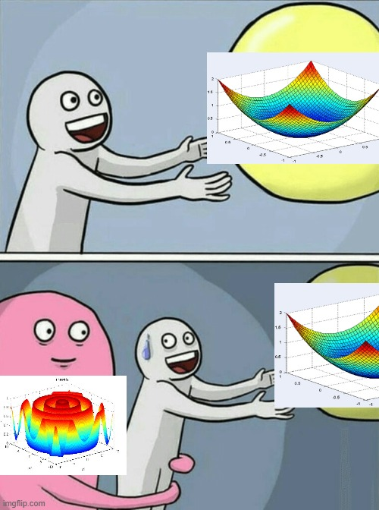
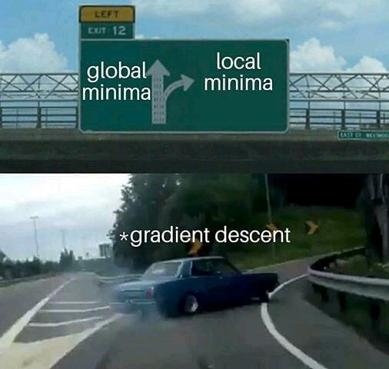
Expectation
Expectation
Reality

Slide 4
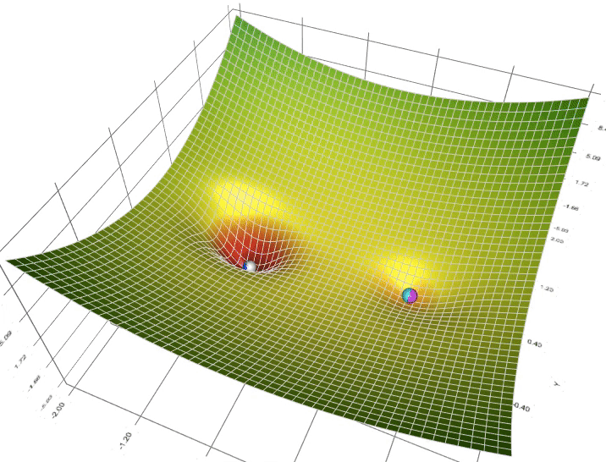
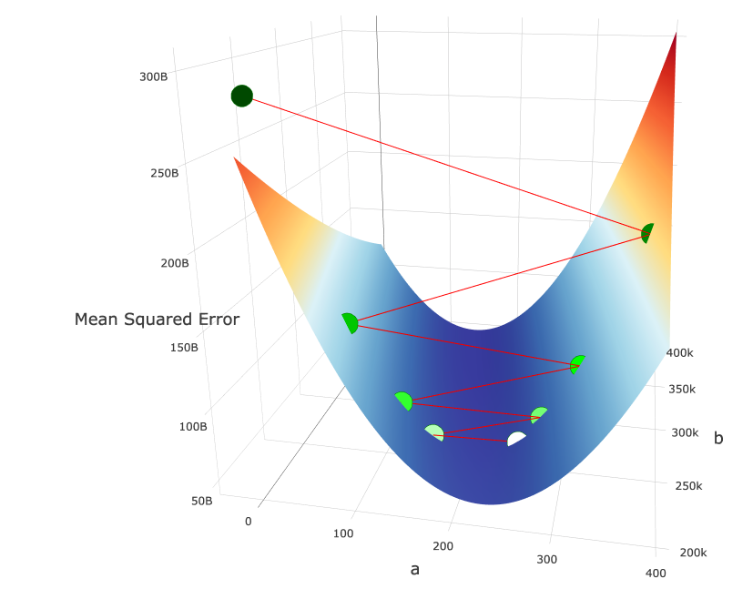
Troublesome functions
Traps you inside local minimum
Shoots you off the domain

Slide 5
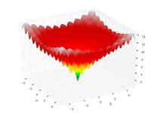
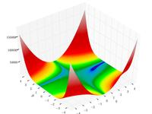
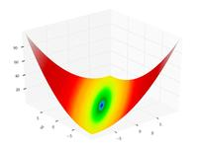
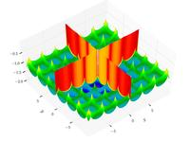
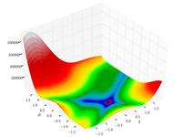
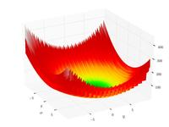
Some of the famous test functions

Slide 6
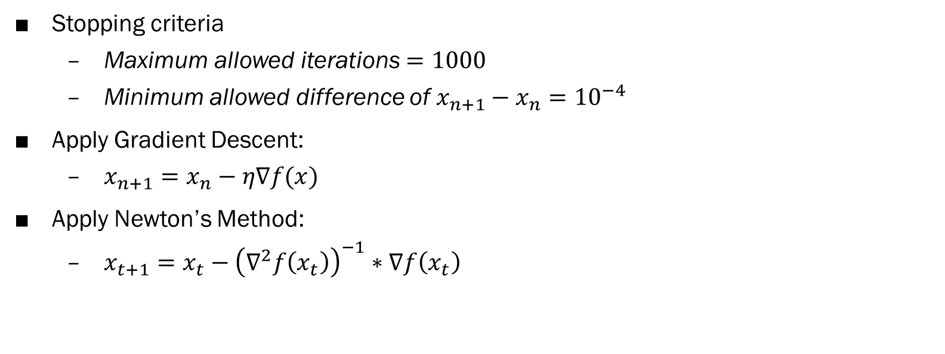
Optimizer setup
Stopping criteria
Maximum allowed iterations $=1000$
Minimum allowed difference of $x_{n+1}−x_{n}={10}^{−4}$
Apply Gradient Descent:
$x_{n+1}=x_{n}−η\text{∇}f(x)$
Apply Newton’s Method:
$x_{t+1}=x_{t}−{\left({\text{∇}}^{2}f\left(x_{t}\right)\right)}^{−1}∗\text{∇}f\left(x_{t}\right)$

Slide 7
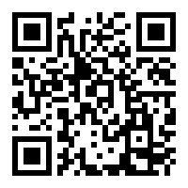
MATLAB Code & Results
Access the code here

Slide 8
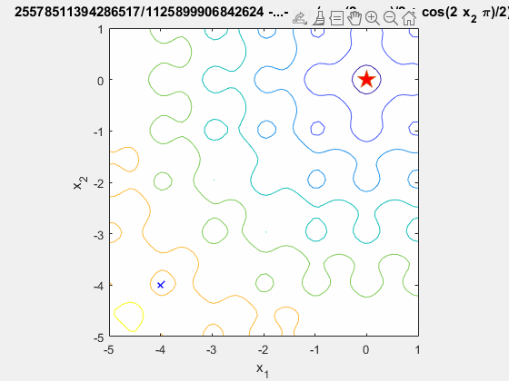


Ackley function

Slide 9
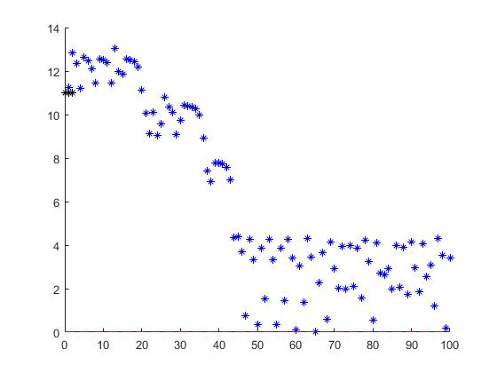
Trapped inside local minimum
Cannot get to the minimum

Slide 10
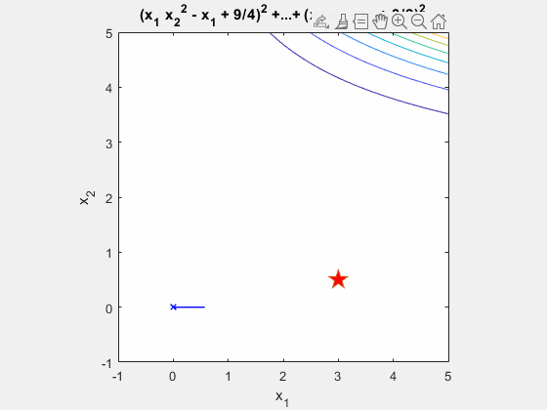

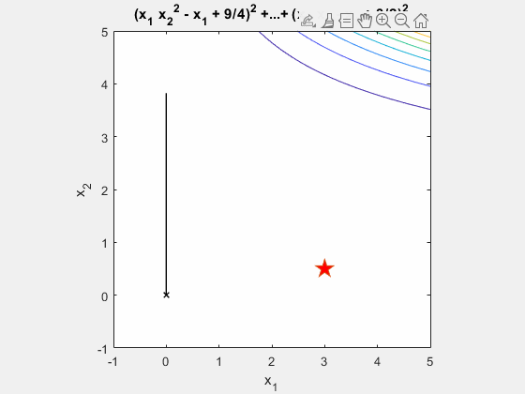
Beale function

Slide 11
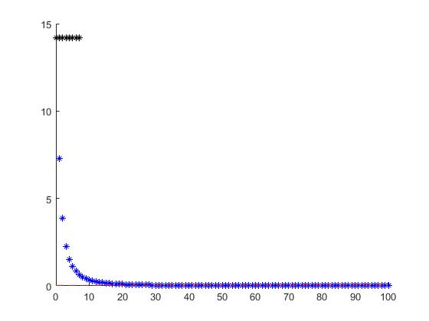
Gradient descent wins!

Slide 12
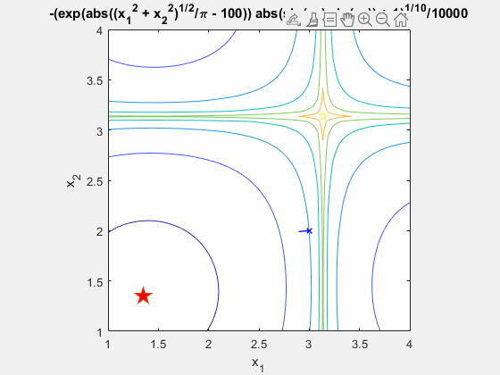

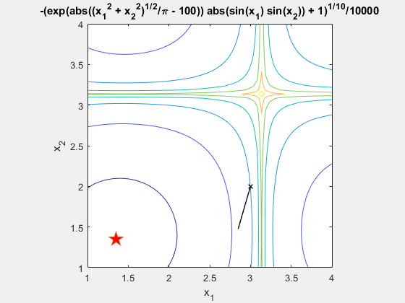
Cross-in-tray function

Slide 13
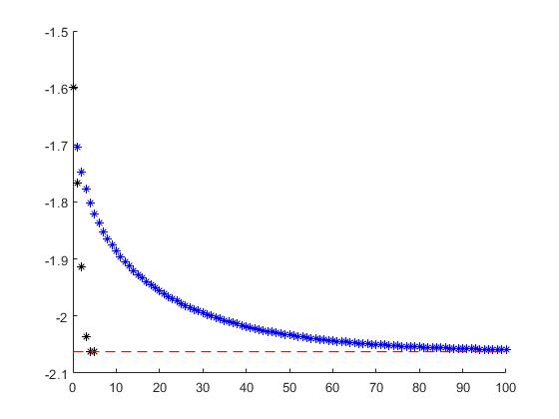
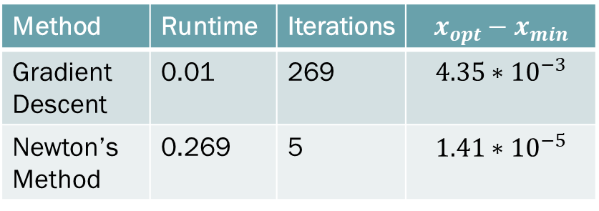
Method | Runtime | Iterations | $$x_{opt}−x_{min}$$
Gradient Descent | 0.01 | 269 | $$4.35∗{10}^{−3}$$
Newton’s Method | 0.269 | 5 | $$1.41∗{10}^{−5}$$
Struggles to get to minimum

Slide 14
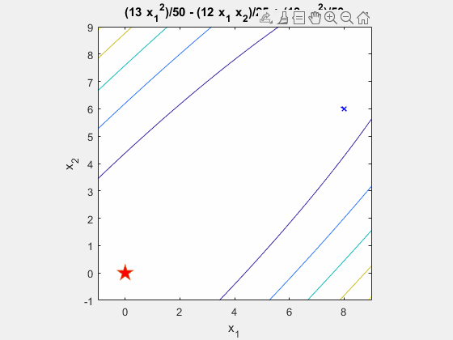

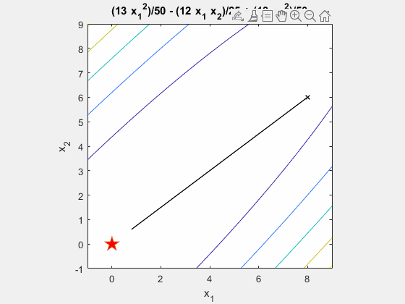
Matyas function

Slide 15
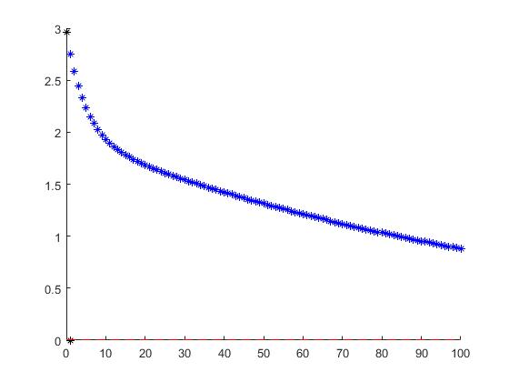
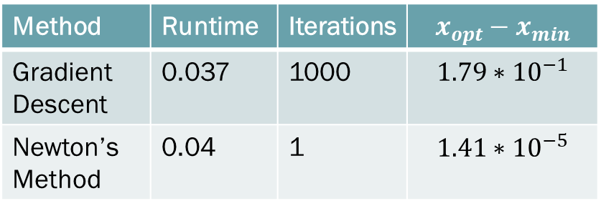
Method | Runtime | Iterations | $$x_{opt}−x_{min}$$
Gradient Descent | 0.037 | 1000 | $$1.79∗{10}^{−1}$$
Newton’s Method | 0.04 | 1 | $$1.41∗{10}^{−5}$$

Slide 16

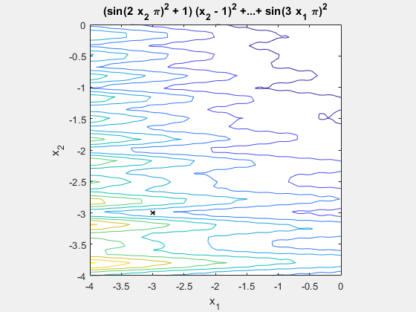
Levi function N.13
Out of search domain in 1 iteration for GD
Trapped here

Slide 17

Goldstein-price function
Out of search domain in 1 iteration for both GD and NM

Slide 18
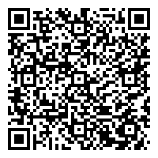
Access data here

Slide 19
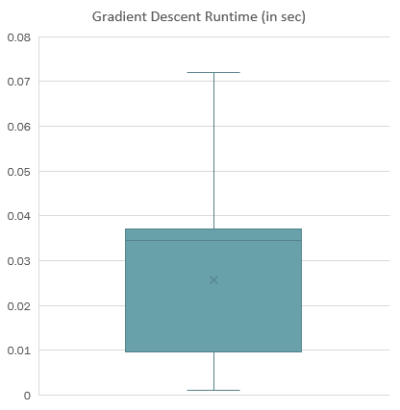
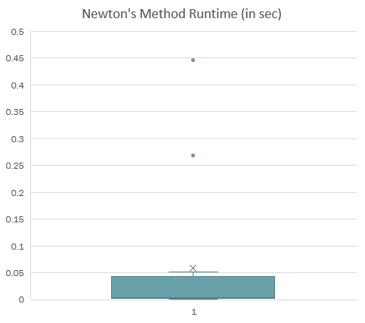
Performance in test function
Average runtime (GD): 0.0257 s
Average runtime (NM): 0.0593 s

Slide 20
Performance in test function
Let’s say we want the solution to be accurate up to 2 d.p.
Accepted percentage of GD: 17.6%
Accepted percentage of NM: 38.9%

Slide 21
Gradient Descent Variations

Slide 22
Motivation of using variations GD

Slide 23
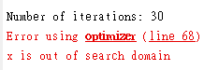
Expectation
Expectation
Reality

Slide 24

Deep learning application
Hope that around a million iterations of one datapoint approximation provides a “good” enough model
1000 times faster

Slide 25
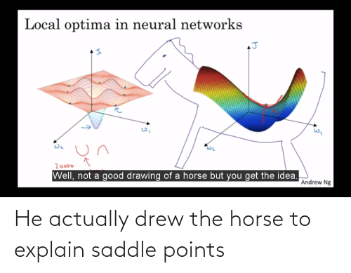
3 Major Difficulties
Cannot compute gradient of large datapoints, e.g sum of 1 billion datapoints
Trapped by
Saddle point
Local minimum

Slide 26
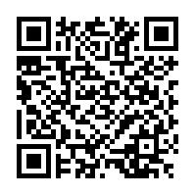
4 Variations of Gradient Descent
Stochastic Gradient Descent
AdaGrad
RMSProp
Adam
Want to play around with the algorithms?

Slide 27
1. Cannot compute gradient of large datapoints

Slide 28
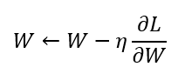
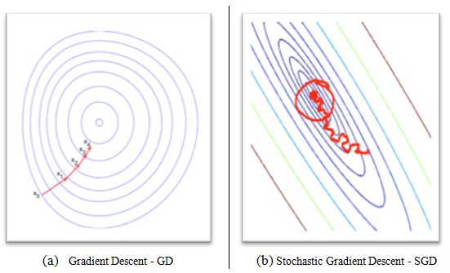


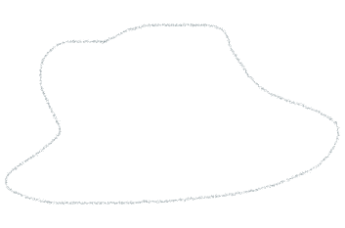








Stochastic Gradient Descent
“One point” approximation of gradient
.
All the variations of GD is based on SGD
randomly picked
Take the steepest route

Slide 29
2. Trapped by Saddle Point

Slide 30
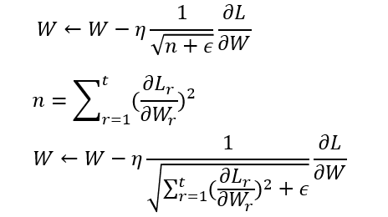
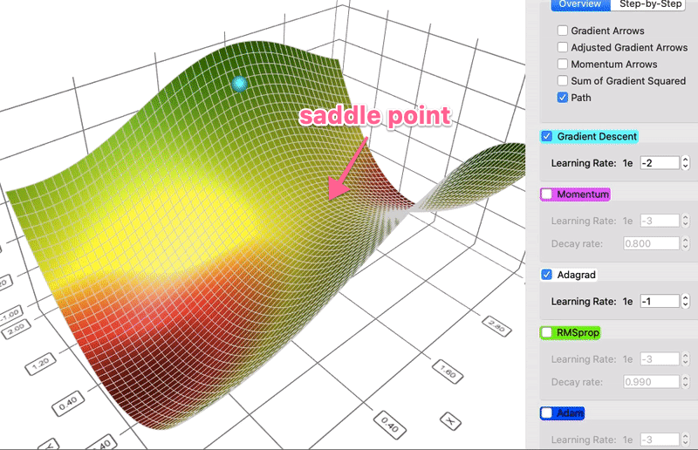
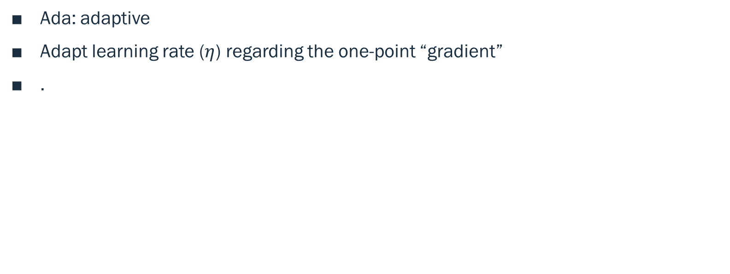
AdaGrad
Ada: adaptive
Adapt learning rate ($η$) regarding the one-point “gradient”
.

Slide 31
When we should use AdaGrad
Less probability of trapping inside saddle point

Slide 32
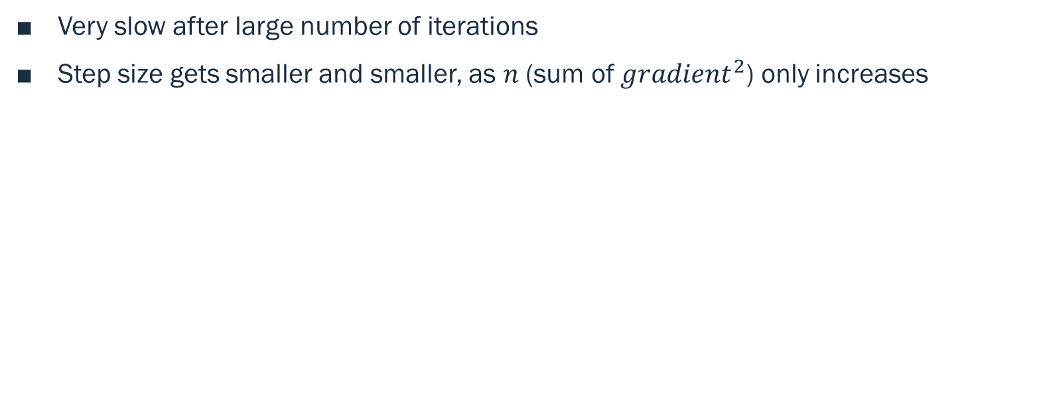
Problem of AdaGrad
Very slow after large number of iterations
Step size gets smaller and smaller, as $n$(sum of ${gradient}^{2}$) only increases

Slide 33
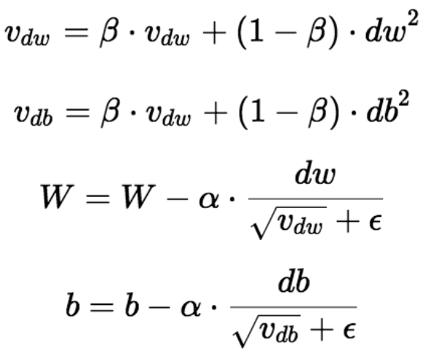
RMSProp
Fix the issue of AdaGrad by decaying value of gradient long time ago, scaling up the recent values
,

Slide 34
3. Trapped by local minimum

Slide 35
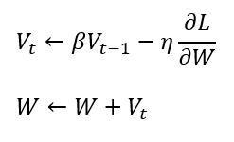
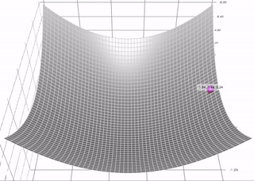

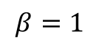
Momentum
If direction of next update = direction of last update, then take a bigger step
Otherwise, take a smaller step
.
influenced by previous update
$$β=1$$

Slide 36
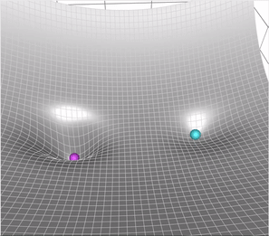
When should we use Momentum
Accelerates the learning speed when gradient is small/noisy
Less probability of getting trapped in local minimum
Clay – GD
Purple – GD with momentum

Slide 37
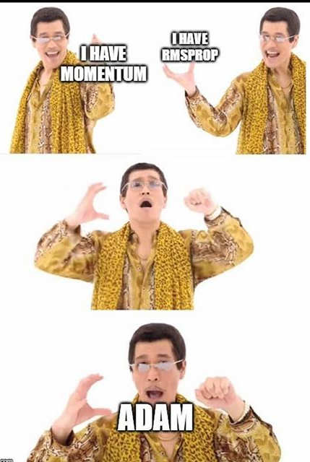
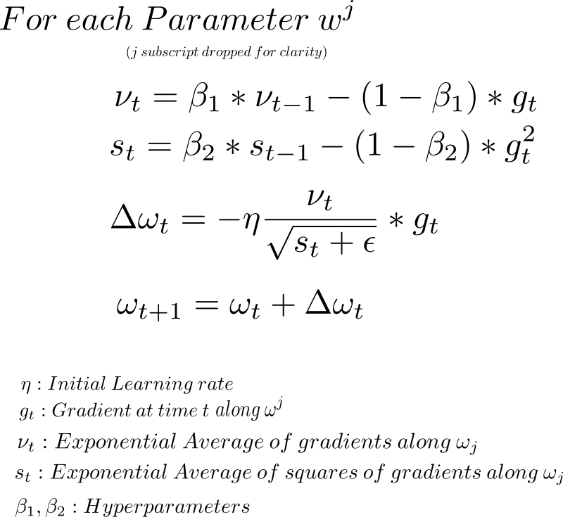
Adam
Combines RMSProp and Momentum
.

Slide 38
How is this applied to deep learning?

Slide 39
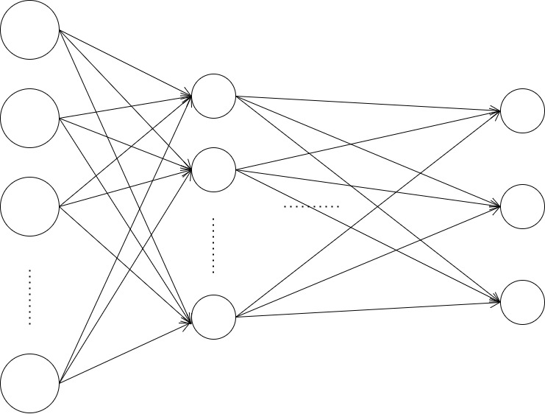
Back Propagation

Slide 40
Back Propagation

Slide 41
Program setup
Python
Dataset: MNIST
Library: TensorFlow (Deep learning layers); Keras (optimizer)

Slide 42

MNIST
Dataset of handwritten digits image labelled with its digit
Used for building models classifying handwritten digits

Slide 43
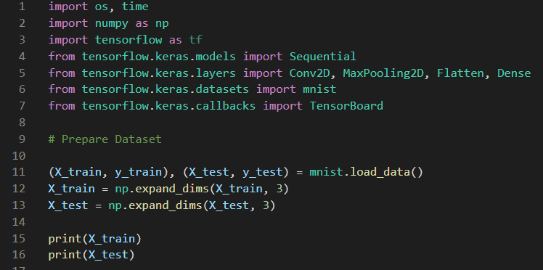

Slide 44
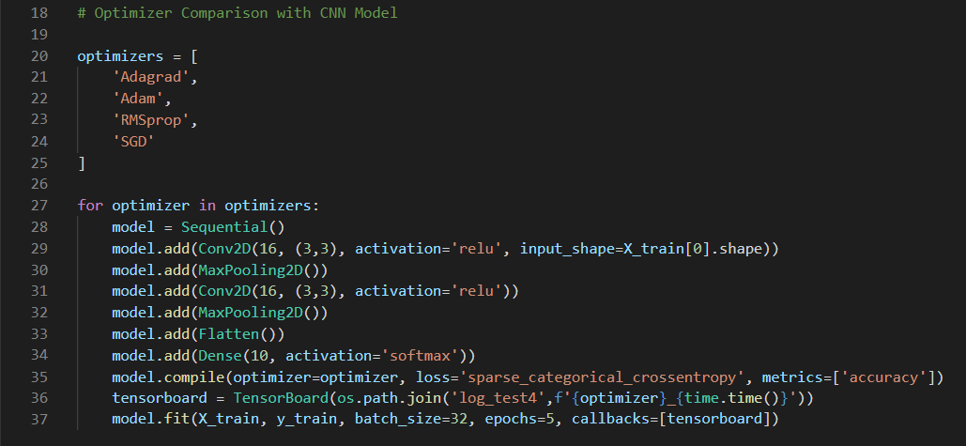

Slide 45
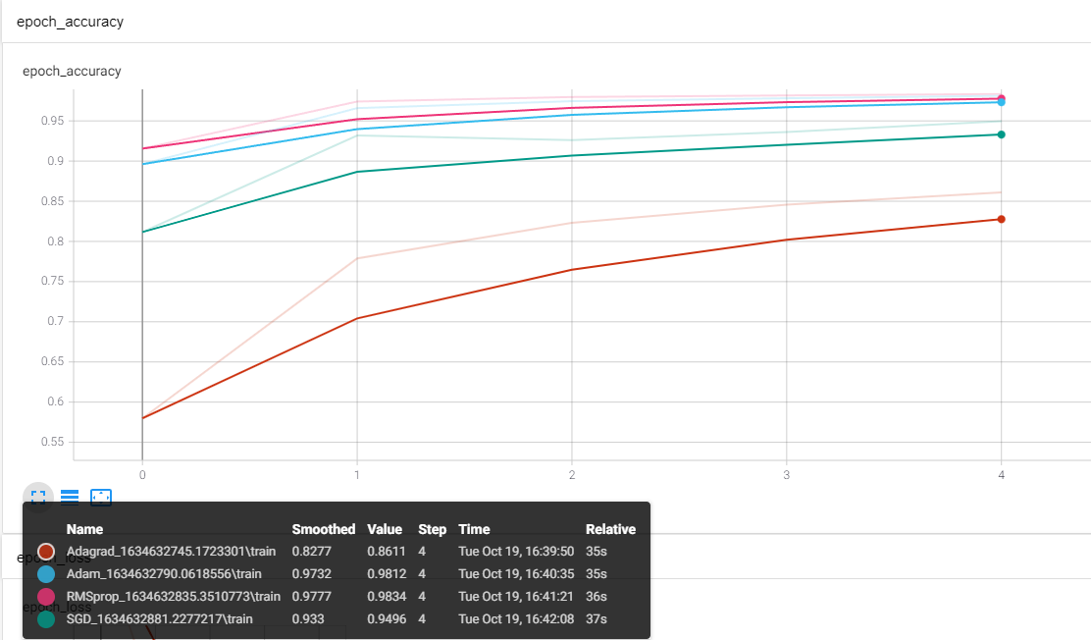
Result

Slide 46
Reference
Surjanovic and Bingham. (2013). Virtual Library of Simulation Examples: Test Functions and Datasets. Simon Fraser University. https://www.sfu.ca/~ssurjano/optimization.html
Gradient Descent Visualization Tool by lilipads https://github.com/lilipads/gradient_descent_viz
Patterson, J., Gibson, A. (2017). Deep Learning: A Practitioner's Approach. Beijing: O'Reilly. ISBN: 978-1-4919-1425-0
Rawat, Waseem & Wang, Zenghui. (2017). Deep Convolutional Neural Networks for Image Classification: A Comprehensive Review. Neural Computation. 29. 1-98. 10.1162/NECO_a_00990.

